Slide 1
Current Topics in MS
Sex & Intimacy in MS

Slide 2
You Are Not Broken
Sex and Pelvic Education for doctors and people who care for people living with MS
Kelly Casperson, MD

Slide 3
Why Me?
Know Some Stuff
Build Your Team
My Story
My Purpose – Connecting People with Education
Sex is Awkward
Vulnerability is the Key to Connection

Slide 4
Sexual health is a state of physical, mental and social well-being in relation to sexuality.
It requires a positive and respectful approach to sexuality and sexual relationships, as well as the possibility of having pleasurable and safe sexual experiences, free of coercion, discrimination and violence.
So what is the problem? 91% of men and 72% of women with MS have reported trouble between the sheets
When you aren't feeling well, you probably won't want sex. That's also known as being normal.

Slide 5
The Hardware
Clitoris-urethrovaginal complex
No such thing as “down there”

Slide 6
The Vulva and Vestibule
Distinct ORGANS
Vestibule – penile urethra
Neglect neglect neglect
All labia are normal

Slide 7
Clitoris
The organ of pleasure
Has a foreskin
Varying distances from vagina

Slide 8
Clitoris
Glans is just the outside

Slide 10
The Vagina
Hollow tube
Pain in the vagina?? Rarely
More prone to infection after menopause

Slide 11
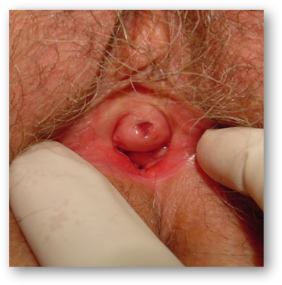
Are You Still Wondering Why Women Get UTIs and Pain?

Slide 12
Genitourinary Symptoms of Menopause
UTI
Dyspareunia
Urinary Urgency
Urinary Frequency
Incontinence/OAB
Yeast infections
Dryness
Itchy
DYSURIA !!!!!!!
Urethral Prolapse!!!!

Slide 14
Vaginal Atrophy
OCP Birth Control
SHBG
Breast Feeding

Slide 16
Medications for the Hardware
OTC – sex lube and moisturizers
Estrogen – topical versus systemic
Ring, cream, tab
Safety spiel
BUT WHEN CAN I STOP IT DOCTOR???
Estrogen and Testosterone
DHEA
Remember the self cleaning oven

Slide 17
The Software
Desire
Orgasm

Slide 18
Desire types
Reactive/Receptive
Spontaneous

Slide 20
Why is arousal so important in pain??

Slide 22
Desire Mismatch

Slide 23
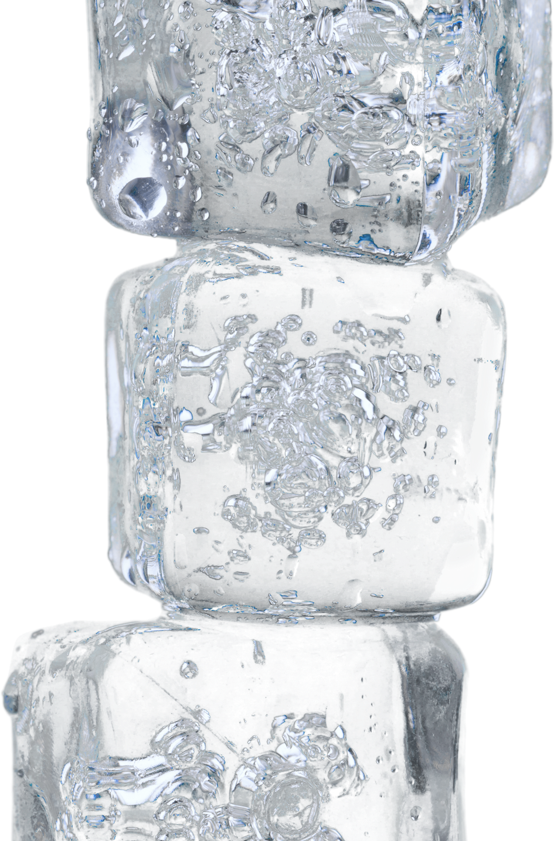
Orgasm Inequality
According to a 2016 study from the Archives of Sexual Behavior that looked at over 52,500 adults in the U.S. — including those who are lesbian, gay, and bisexual — 95 percent of heterosexual men reported they usually or always orgasmed during sex, compared to 65 percent of heterosexual women, who were the least likely.

Slide 24
Difficulty achieving an orgasm is common among both men and women with MS. It may be caused by MS lesions, reduced sensation, or side effects of medications. Antidepressants are often the culprit.

Slide 25
PIV Sex
2015 study of 1,000 women
slightly more than 18 percent reported they orgasmed from intercourse alone.
PIV lasts 3-5 minutes – but, women take up to 30 minutes
Getting back to that low desire issue…..

Slide 26
What is the Main Reason for Orgasm Inequality?
01
02
Lack of Anatomy Knowledge
Society’s belief that a woman’s pleasure isn’t as important

Slide 29
Is Sexual Desire Related to Self-esteem?
Some people with MS develop a negative self-image, either because they don't like how they look, they miss what they can't do anymore, or they feel like a burden on their partners. Perhaps they hold the common societal view that people with disabilities aren’t sexual individuals.
A low self esteem can bring desire down with it.

Slide 30
First Line Desire/Arousal Treatment
Lubricants (Water and Silicone)
Moisturizers, toys/devices, self discovery
OTC options
Arginmax for women
Stronvivo
Topical Zestra
Genital numbness is a very common symptom in men and women with MS, and it's caused by lesions in the spinal cord

Slide 31
Medications for Software
Bremelanotide
Filbanserin
Buproprion
Sildenafil
Testosterone

Slide 32
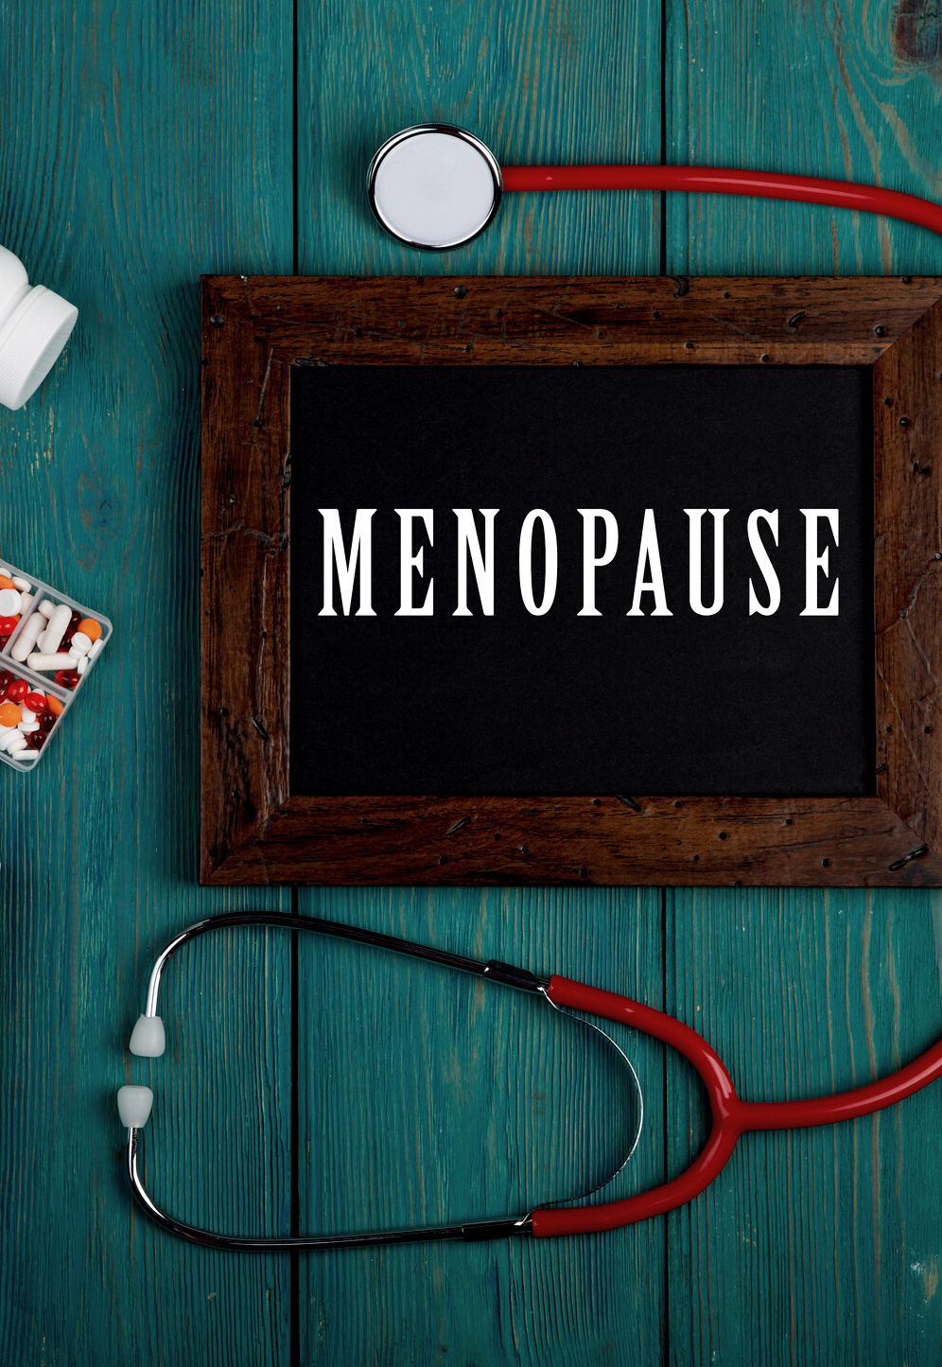
If Estrogen is the Secret, Testosterone is the secret secret

Slide 34
Build Your Team
Know your vulva
Normalize the experience
Sex therapists
Physical therapists

Slide 36
WE ARE NORMAL
Statement: Many people with MS have concerns about their intimate relationships
Ask: Have you experienced any issues?
Treat or refer
You are a Rockstar for asking

Slide 38
Tips and Tricks
01
02
03
Get out of your head
Mindfulness
Practice
Curiosity
Communication
Arousal can lead to desire (this is normal!), no pressure, remember pleasure is the goal
Lube (arousal desire mismatch)

Slide 39
Erectile Dysfunction
Inability of a man to maintain an erection sufficient for satisfying sexual activity.
There's no age limit on Viagra, young or old

Slide 40
My Top Five (A Recap)
Vaginal estrogen
Sex therapy
Orgasmic inequality
Pain is NEVER normal
Responsive desire is majority!

Slide 41
Learn More and Resources
Podcast – You Are Not Broken
ISSWSH www.isswsh.org
Meet Rosy app www.meetrosy.com
Come As You Are Emily Nagoski PhD
The Definitive Guide to Sex and Disability Miriam Kaufman, MD
She Comes First Ian Kerner
Becoming Cliterate Laurie Mintz PhD
Women’s Anatomy of Arousal – Sheri Winston
www.aasect.org

Slide 42
Remember: You Are Not Broken

Slide 43
What’s On Your Mind?
Please type your question into the question box
Notes:
Live questions

Slide 44
Thank you
www.nationalMSsociety.org/currenttopics

