Slide 1


The CME program will start on the hour.
Assessing and Addressing Cognitive and Psychological Symptoms in People with MS: A Whole Health Approach

Slide 2

VA MS Centers of Excellence Mission
Improve the quality and consistency of health care services delivered to Veterans with MS across the US.
Expand care coordination between VA medical facilities through the development of a national network of MS providers within the Veterans Health Administration.

Slide 3
Vision & Mission Statements
​​Our Vision:
A World Free of MS.
Our Mission:
We will cure MS while empowering people affected by MS to live their best lives.

Slide 4
Diversity,
Equity & Inclusion Statement
The National Multiple Sclerosis Society is a movement by and for all people affected by MS. Our voices and actions reflect diversity, equity and inclusion.
We welcome and value diverse perspectives.
We actively seek out and embrace differences.
We want everyone to feel respected and be empowered to bring their whole selves to ensure we make the best decisions to achieve our mission.

Slide 5
Your feedback is important to us!
At the conclusion of the webinar, please complete the program survey. This must be completed within 15 days of the live program.

Slide 6

Dr. Moira C. Dux, Ph.D. (she/her/hers) is the Psychology Training Program Director at the VA Maryland Health Care System. She is responsible for broad programmatic oversight of all levels of psychology training, and she is actively engaged in interdisciplinary research, training, and clinical service delivery. Dr. Dux’s clinical and research interests center on understanding the spectrum of factors that may underlie neurocognitive difficulties in individuals with neurologic conditions, infectious diseases, and/or vascular dysfunction, as well as evaluation and implementation of non-pharmacologic approaches (e.g., exercise, cognitive rehabilitation) for enhancing brain health and cognitive wellness.

Slide 7

Dr. Terry Lee-Wilk, Ph.D. is the Program Manager of Neuropsychology at the VA Maryland Health Care System and Adjunct Assistant Professor in the Department of Neurology at the University of Maryland School of Medicine. She is the Director of the VA Maryland Health Care System MS Neuropsychology Core and serves as co-chair of the Consortium of Multiple Sclerosis Centers Mental Health Providers Special Interest Group.

Slide 8






Assessing and Addressing Cognitive and psychological symptoms in people with multiple sclerosis (MS):
A whole Health Approach
November 1st, 2023
Terry Lee-Wilk, Ph.D. & Moira Dux, Ph.D.
www.maryland.va.gov

Slide 9
Disclosures & Disclaimers
Drs. Lee-Wilk and Dux have no relevant financial or non-financial interests to disclose.
The views expressed within this presentation are those of the speakers and are not representative of the Veterans Healthcare Administration or any other entity of the Federal Government.

Slide 10
Goals and participation:
We are aspiring to cultivate an open, respectful, and humble stance throughout today’s presentation; we welcome your feedback and input
We recognize that we are presenting through our own lenses of bias shaped, in part, by our lived experiences
We are dedicated to the lifelong process of self-evaluation regarding our identities, positions of privilege and power, gaps in our knowledge and our biases, AND contributing to advocacy actions to address factors that perpetuate inequities
Toward the end we will have a Q & A portion, please participate in the way(s) that are best suited to your learning needs and personal considerations.

Slide 11
objectives
Describe
common cognitive and psychological symptoms associated with MS
Review
frameworks that help to facilitate holistic and contextualized care
Discuss
how to apply the VA Whole Health approach in providing tailored care

Slide 12

Take Home Points up front
MS is a heterogeneous disease and each person’s presentation is unique and may be impacted by sociocultural factors and comorbidities. Understanding the context in which the disease occurs is critical in promoting tailored clinical care across the disease continuum.
Comprehensive, holistic approaches to clinical care that incorporate the empirical base and a patient’s values, goals, and care communities are recommended.

Slide 13

goal: utilize a Person-centered, contextualized approach to care

Slide 14
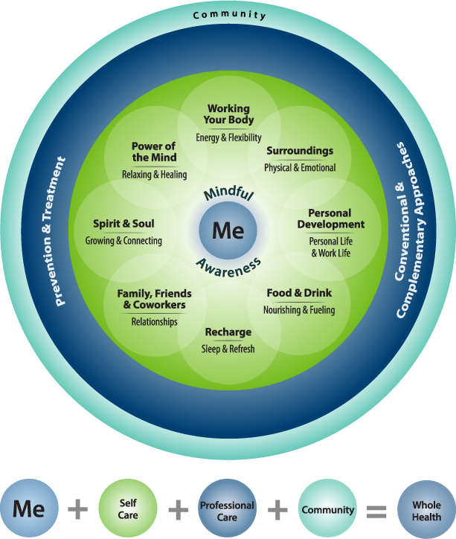
VA whole health model
https://www.va.gov/wholehealth/

Slide 15
MS Historical context and collaborative care

Slide 16

What is Multiple Sclerosis?
MS is a neurologic disease that manifests in a variety of physical, cognitive, and psychological symptoms that, over time, can vary widely within and between people with MS
Psychological
Cognitive
Vision
Dizziness
Vertigo
Speech
Swallowing
Respiratory
Bowel & Bladder
Pain
Fatigue
Weakness
Sexual
Numbness
Tingling
Spasticity
Gait
Comprehensive, collaborative care is key!
CMSC_WhitePaper_Comprehensive_Care_in_MS.pdf (ymaws.com)
The Multiple Sclerosis Centers of Excellence: A Model of Excellence in the VA - PMC (nih.gov)

Slide 17


Historical context of MS
Dr. Friedrich von Frerichs (1849)—first to note cognitive symptoms in MS, approximately 25 years after initial clinical description
Jean-Martin Charcot (1868): “a marked enfeeblement of the memory; conceptions are formed slowly…” He also described psychiatric symptoms such as pathological laughing and crying, euphoria, mania, hallucinations, and depression.
  His patient, Mademoiselle V was characterized as having a fit of lypemania (severe depression), as well as hallucinations and paranoia.
Late 19th and early 20th century: cognitive dysfunction not consistently recognized as a symptom of MS

Slide 18




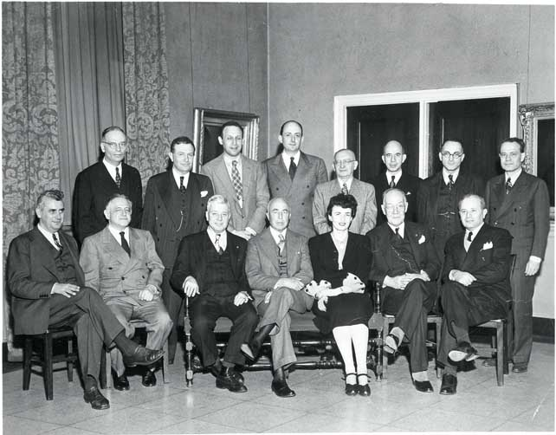
What’s the Historical Significance of Cognitive and Psychological Symptoms in MS?
1946: The National MS Society was founded by Sylvia Lawry
  The NMSS remains a powerful force today and has extensive educational information and resources related to cognitive and psychological symptoms of MS.
1950s: Empirical research on the frequency of depression in individuals with MS commenced
1960s: Medical students typically taught that cognition not affected in MS
1970s: Medical students taught that cognition may be affected in a small proportion of individuals with MS (e.g., <5%)
1980s: Increased awareness and empirical research related to cognitive and psychological symptoms associated with MS
1986: Consortium of Multiple Sclerosis Centers (CMSC) established and centered on team-based care for MS

Slide 19
Why multi- or inter-disciplinary care for ms?
Multi-dimensional team model most effective and efficient treatment approach for MS (Harris et al., 2003; Vickery et al., 2000; Forbes, 2007)
“An interdisciplinary approach to MS care facilitates coordination of services and continuity of care, while avoiding duplication and fragmentation for the patient and family.”
Interdisciplinary care for MS embodies notion of patient empowerment

Slide 20
Epidemiology of ms

Slide 21
Prevalence & Incidence
Worldwide Prevalence: MS organizations have estimated that 2.3 million people are living with MS worldwide.
US Prevalence: Nearly 1 million adults living with MS in the United States. This is more than twice the previously reported number from a national study in 1975 and subsequent updates (Wallin, et al., 2019)
Incidence (new cases): With the challenges inherent in promptly and correctly identifying people with MS, arriving at an accurate incidence figure has been virtually impossible.

Slide 22
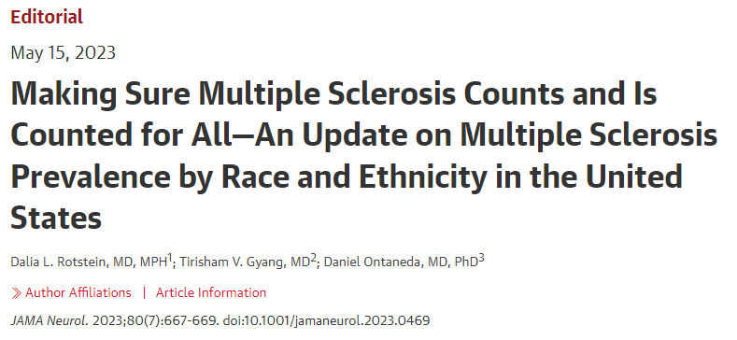
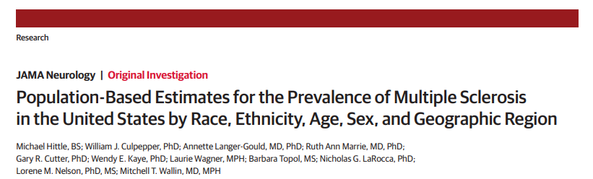

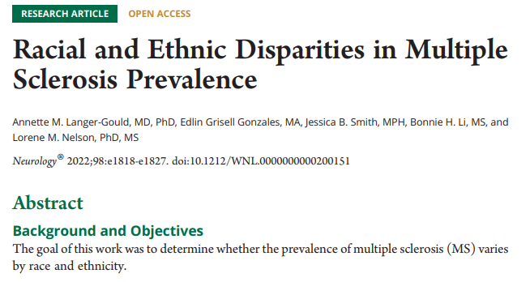

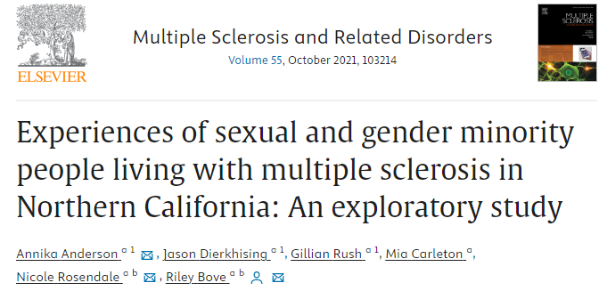
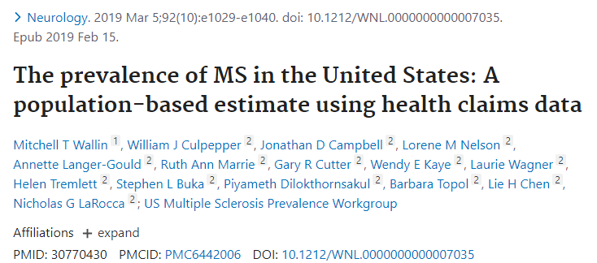
MS previously regarded as a disease impacting White women
Historically, there has been limited inclusion of minoritized groups in MS epidemiologic research
More recent studies demonstrate that MS has affected White and Black Americans at similar rates for decades
Lack of awareness of MS rates/symptom presentations in select groups → delays in access to appropriate care
Evidence of worse clinical outcomes for some underrepresented populations

Slide 23


Social determinants of health
Non-medical factors that impact health outcomes, including the conditions in which people are born, develop, live, function in different roles, and age, are collectively referred to by the World Health Organization as social determinants of health (SDOH; Social determinants of health (who.int)).
https://www.cdc.gov/publichealthgateway/sdoh/index.html
https://www.publichealthequity.org/

Slide 24
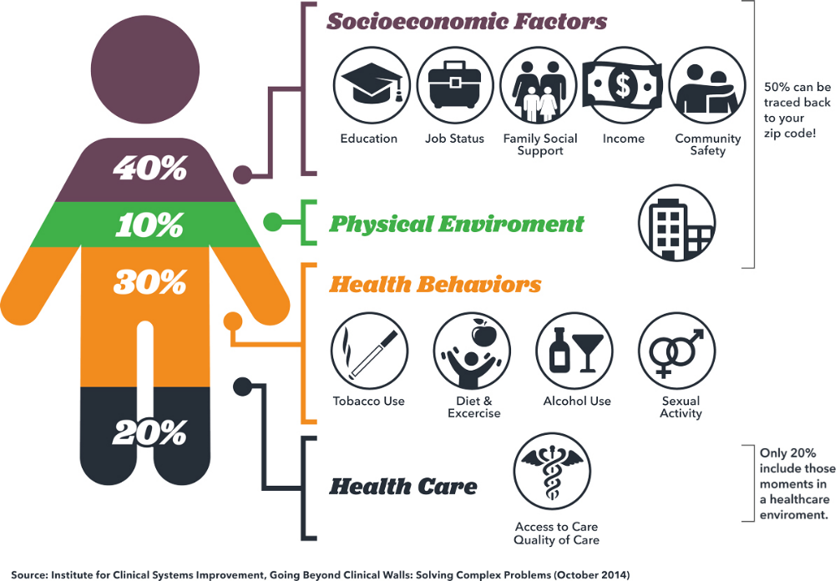
https://www.countyhealthrankings.org/explore-health-rankings
Hood, C. M., K. P. Gennuso, G. R. Swain, and B. B. Catlin. 2016. County health rankings: Relationships between determinant factors and health outcomes.
American Journal of Preventive Medicine 50(2):129-135. https://doi.org/10.1016/j.amepre.2015.08.024

Slide 25
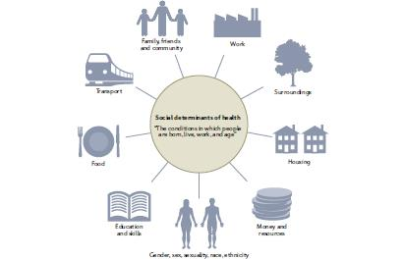
Social determinants of health in ms

Slide 26
Cognitive and psychology symptoms associated with ms

Slide 27
Misconceptions About Cognition in MS
Cognitive dysfunction in MS is rare
  Cognitive symptoms are evident in up to 70% of individuals with MS
Cognitive dysfunction can be evaluated with a few open-ended questions
  Formal neuropsychological evaluation is the gold standard for assessment of cognition
Cognitive dysfunction is strongly associated with physical symptoms in MS
  Cognitive and physical symptoms are only weakly related to one another
Cognitive dysfunction is only apparent in people with progressive MS
  Cognitive symptoms are common across MS subtypes
Cognitive dysfunction in MS is similar to Alzheimer’s disease (AD)
  Cognitive symptoms in MS are often distinct from those common in AD and typically milder

Slide 28


Cognitive & Psychological Symptoms in MS
Historically, physical and sensory symptoms have garnered more attention and intervention from providers
Cognitive and psychological symptoms have been under-recognized, inadequately assessed, and under-treated
  Symptoms are “invisible” and may be associated with stigma
Cognitive and psychological symptoms often emerge early, are common across different types of MS, can persist across the course of the disorder, and negatively impact a range of factors (e.g., occupational status, quality of life).
→These symptoms can be addressed.

Slide 29
Prevalence of Cognitive and psychological Symptoms in MS
Approximately 40-65% of people with MS experience cognitive symptoms
Approximately 30-50% of individuals with MS experience some form of psychological distress (e.g., depression, anxiety).

Slide 30
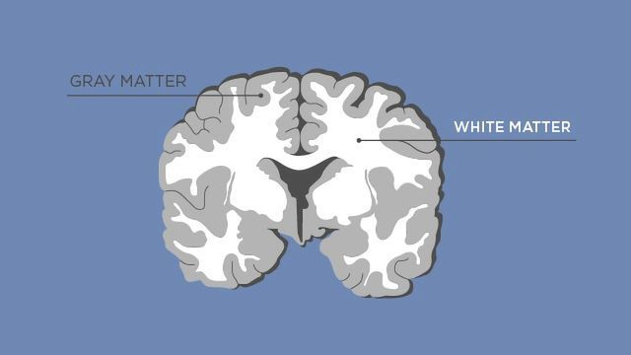
Onset, Course, and Severity of Cognitive Symptoms
Cognitive symptoms tend to emerge gradually, early in the disease course
  In fact…cognitive impairment appears to predate the appearance of structural abnormalities on magnetic resonance imaging (MRI) and may serve as an early marker of disease activity (Cortese, et al., 2016)
The majority of individuals with MS experience mild cognitive symptoms
Cognitive symptoms are not ameliorated with disease-modifying treatments (DMTs)
Some evidence that cognitive symptoms increase during MS relapses and cognitive function does not return to pre-relapse levels (e.g., Morrow et al., 2011)
Cognitive symptoms are more frequent and often more severe in the progressive variants of the disease and in patients with comorbidities (e.g., cerebrovascular disease, other autoimmune conditions, etc.)

Slide 31
What are the Most Common Cognitive Symptoms in MS?
Information Processing Speed
Learning & Memory
Executive Functioning
*Acquisition of new information especially impacted. With increased exposure to and repetition of information, recall, retention, and recognition often intact.

Slide 32
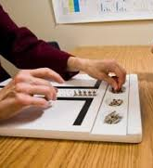

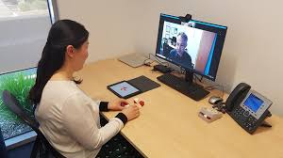
Why is Objective Cognitive Assessment Important (CONT.)?
*Per AAN, clinicians typically unable to detect cognitive impairment based on routine neurologic evaluation and interview
Disability in MS is typically captured with the Expanded Disability Status Scale (EDSS) which relies primarily on clinician’s perception of cognition (or report of an informant)
  Studies have shown that when objective measures are used to assess cognition to inform EDSS score, the total score changes
The National MS Society and AAN recommend at least annual cognitive evaluation
  NMSS Guidelines (also endorsed by Consortium of Multiple Sclerosis Clinical Centers and the International Multiple Sclerosis Cognition Society): Kalb et al., 2018: https://pubmed.ncbi.nlm.nih.gov/30303036/

Slide 33
What types of psychological symptoms may occur in mS?
Most Common
Depression
Anxiety
Adjustment difficulties
Less Common
Euphoria: Persistent happiness that is disproportionate to circumstances and can distort one’s view of reality.
More common in the later stages of the disease and in those with more advanced cognitive impairment
Pseudobulbar Affect: Uncontrollable bouts of laughing and/or crying (mood incongruent). Affects approximately 10% of people with MS.

Slide 34



How Common is Suicidal Ideation & Death by Suicide in Individuals with MS?
Lifetime prevalence of suicidal ideation is approximately 30% in people with MS. Research has demonstrated that individuals with MS are more than twice as likely to attempt suicide as the general population and about twice as likely to complete suicide. Factors associated with increased risk include:
  Identifying as male
  Living alone
  Severe depression
  Overuse of alcohol
https://www.veteranscrisisline.net/
https://www.samhsa.gov/find-help/988

Slide 35

How are Psychological Symptoms Assessed?
Psychological assessment should be part of comprehensive care in MS
  Multiple studies document relatively low treatment rates, likely due to undiagnosed psychological disorders
Several studies have documented the utility of a range of brief assessment measures:
  Generalized Anxiety Disorder-7 & 2-Item Scales (GAD-7/GAD-2)
    Comparable sensitivity and specificity
  Hospital Anxiety and Depression Scale (HADS)
  Beck Depression Inventory-2nd Edition (BDI-2)
  Patient Hospital Quesionnaire-9 (PHQ-9)

Slide 36





How are Psychological Symptoms Assessed?
More comprehensive measures:

Slide 37

What Other Factors Contribute to Cognitive and psychological Symptoms in Individuals with MS?
Medical and mental health comorbidities
Vascular dysfunction
Metabolic dysfunction
PTSD, depression, anxiety
Medication effects
Pain
Fatigue
Disrupted sleep
Social determinants of health
COVID-19
Home | COViMS

Slide 38
Holistic frameworks: considerations & Approaches

Slide 39







Tips for Holistic clinical approaches
Focus on evolution of YOUR knowledge; check biases often and routinely seek a variety of sources to expand perspectives, skills, and awareness of resources
  humility, compassion, courage, and critical thinking
Seek and incorporate information regarding a patient’s identities and values
View the patient in their unique context(s)
Inquire about a patient’s understanding of and goals for assessment and/or treatment
Tailor the assessment and/or treatment processes
Provide assessment results and/or treatment summaries as well as any tailored follow-up recommendations

Slide 40
VA whole health model
VA’s approach to care that supports overall health and well-being.
Whole health centers are what matters to individuals, emphasizing their values, needs, and goals
Integrates physical and mental health
Incorporates conventional and complementary care approaches
Offers resources and tools for patients and providers that can be utilized across the care continuum
https://www.va.gov/wholehealth/

Slide 41
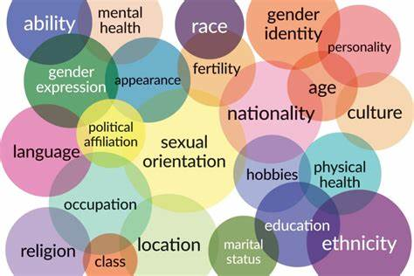

Who am I working with?
What are their identities and values?
How do they overlap or differ from my own?

Slide 42

ADDRESSING framework provides a structure for:
cueing one to think about aspects of culture and identity that are commonly overlooked
recognizing the complexity and intersectionality of the human experience and identity
generating hypotheses and well-informed questions to better understand the impact of cultural influences on oneself and others
Involves personal and interpersonal work

Slide 43
ADDRESSING Framework
Cultural Influence | Dominant Group | Nondominant Group/Minority
Age & generational influences | Young and middle-aged adults | Children, older adults
Developmental disabilities & Other Disabilities | Nondisabled individuals | People with cognitive, intellectual, sensory, physical, and mental health disabilities
Religion & spirituality | Christian & secular | Muslims, Jews, Hindus, Buddhists, and other religions
Ethnic & racial identity | White people/European Americans | Asian, South Asian, Latinx, Pacific Islander, African, Arab, Black, African American, Middle Eastern/North African, and individuals of multiple races
Socioeconomic status/social class | Upper- and middle-class | Individuals of lower status by occupation, education, income, or inner city/rural habitat
Sexual orientation | Heterosexual | Gay, lesbian, bisexual, pansexual, and/or asexual
Indigenous heritage | European Americans | American Indians, Iñuit, Alaska Native people, Métis, Native Hawaiians, New Zealand Mãori, Aboriginal Australians
National origin | U.S.-born Americans | Immigrants, refugees, international students
Gender | Men | Women, transgender, non-binary, agender, and/or gender-questioning

Slide 44
ADDRESSING Framework
Personal work
Introspection, self-exploration, and appreciation of cultural influences on one’s beliefs, thinking, behavior, and perspectives
Recognition of the areas in which you are a member of a dominant group (in a particular context) is an important step in becoming more aware of potential limitations in your knowledge, experiences, and understanding of individuals who fall into nondominant designations for those same categories
Practice pointers:
Approximate constellations of privilege for you and your patient to help uncover your potential knowledge/experience gaps
Examine assumptions and biases and seek reputable information to address limitations
How are your salient identities interacting with those of your patient?
How might you be perceived by your patient on the basis of your visible identities?
Implicit association test: https://implicit.harvard.edu/implicit/takeatest.html

Slide 45
ADDRESSING Framework
Interpersonal work
Focus on learning from and about other cultures
Practice pointers:
Employ a process of forming hypotheses and questions and seeking information to shape conceptualization and approach
ADDRESSING framework draws attention to visible and less visible dimensions of culture and intersectionality
Goal is to form a strong rapport with patient and to provide empirically-guided, tailored care (assessment, intervention, consultation)
Enhances creditability, efficiency, and accuracy
How a patient self-identifies is very important for gaining a better understanding of their values, perspectives, and behavior (e.g., can identify with dominant and nondominant group simultaneously; self-identity can vary across settings and over time)
Exhibit flexibility…the relative impact and relevance of factors will vary significantly across clients

Slide 46


https://www.apa.org/about/apa/equity-diversity-inclusion/language-guidelines.pdf?_ga=2.95769759.2032274610.1661720287-904457662.1628880313
https://www.ama-assn.org/system/files/ama-aamc-equity-guide.pdf

Slide 47
Language considerations
Keep up-to-date on the evolution of language and impacts
Be aware of the broader societal meaning of terms and seek ingroup meanings of cultural terms
Apply flexibly and try to avoid making assumptions that a client or colleague prefers a term noted in a guide
Actively listen for how the person describes themselves
If you’re not sure of a person’s preference, ask them
Acknowledge when you use language that lacks sensitivity

Slide 48
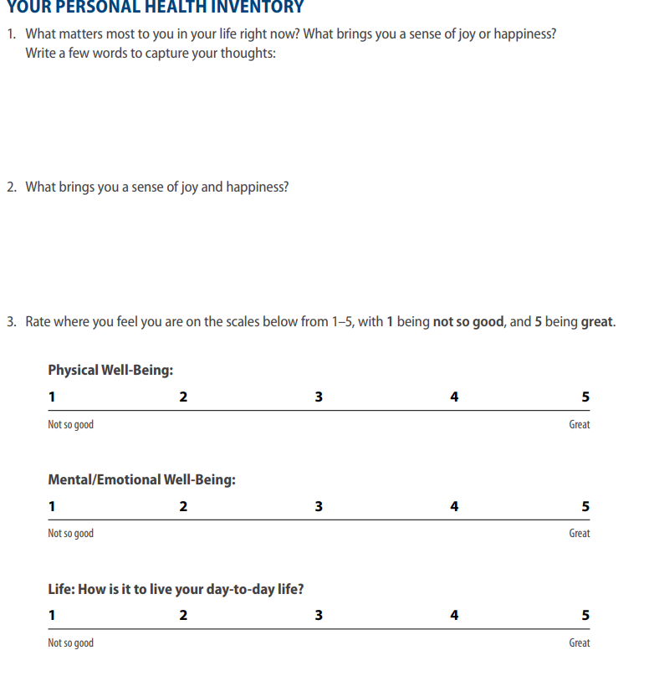
View the patient in their unique context(s)
Inquire about patient’s understanding of and goals for assessment and/or treatment
Tailor the assessment and/or treatment processes

Slide 49
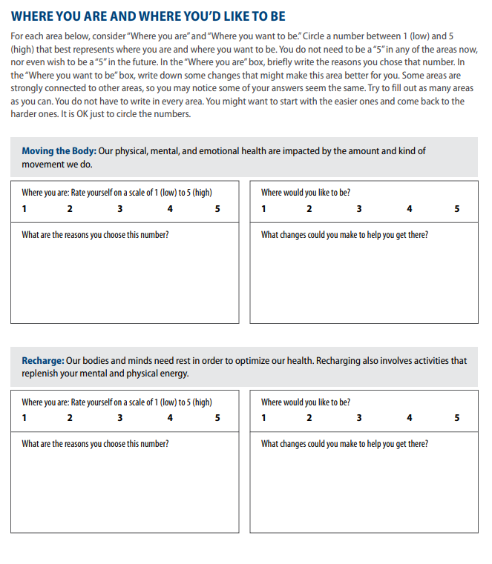




Slide 50
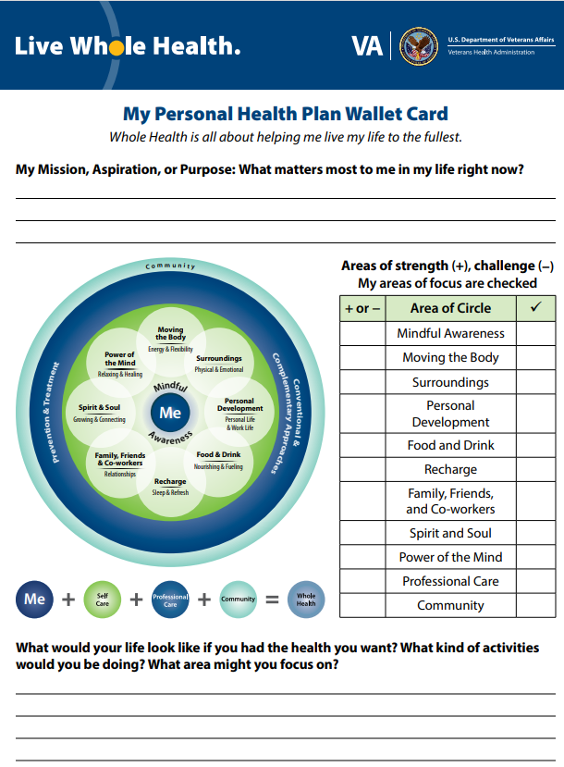
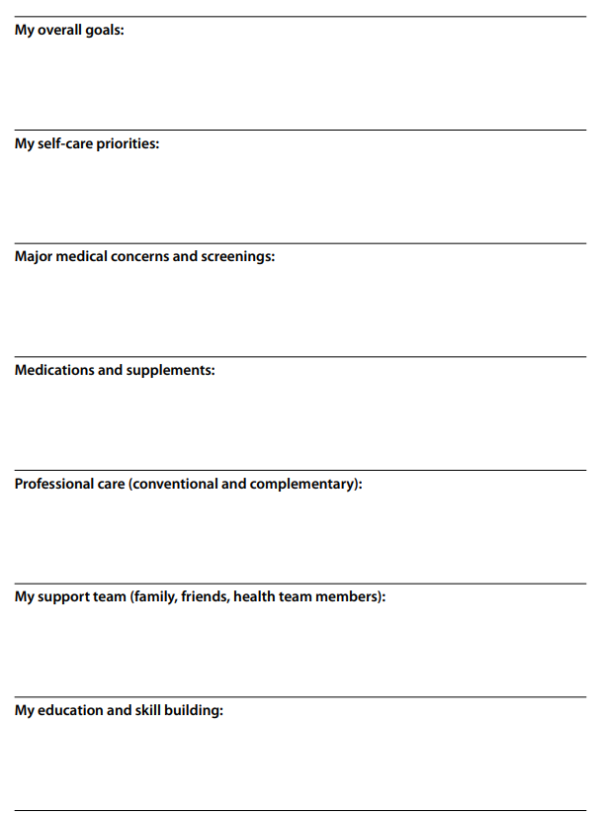

Slide 51
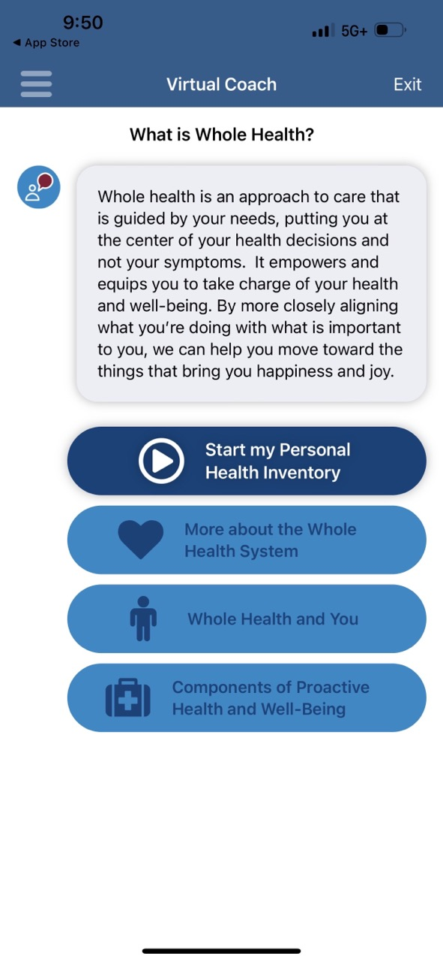
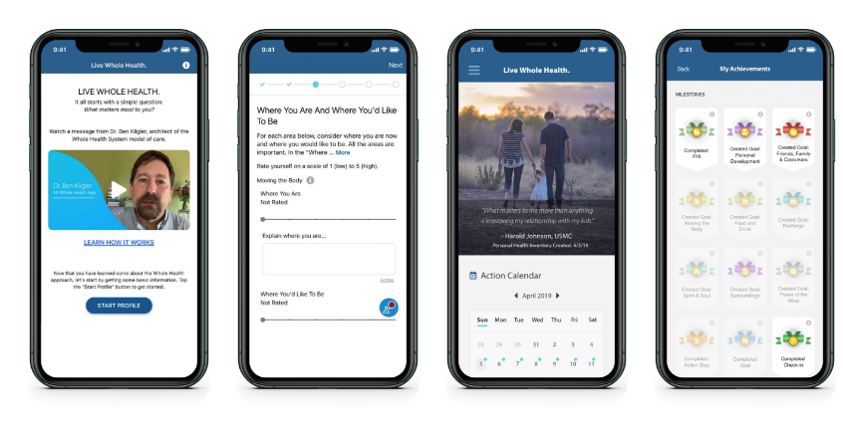

VA WHOLE HEALTH RESOURCES FOR Patients
VA Whole Health Basics: https://www.va.gov/WHOLEHEALTH/veteran-resources/whole-health-basics.asp
VA Whole Health App (free): https://mobile.va.gov/app/live-whole-health
Additional Whole Health Online & Mobile Tools: https://www.va.gov/WHOLEHEALTH/veteran-resources/MobileApps-OnlineTools.asp

Slide 52

VA WHOLE HEALTH RESOURCES FOR PROVIDERS
Tools for providers regarding complementary and integrative health: https://www.va.gov/WHOLEHEALTH/professional-resources/clinician-tools/cih.asp
Whole Health Library: includes information about Whole Health approaches, specific conditions, and tools to assist with care
  For example, whole health information regarding Multiple Sclerosis: https://www.va.gov/WHOLEHEALTHLIBRARY/tools/multiple-sclerosis.asp
Educational courses/online trainings: https://www.va.gov/WHOLEHEALTHLIBRARY/courses/index.asp
Self-care resources for providers: https://www.va.gov/WHOLEHEALTH/professional-resources/EWH-Resources.asp
Evidenced-Based Research updates: https://www.va.gov/WHOLEHEALTH/professional-resources/clinician-tools/Evidence-Based-Research.asp

Slide 53
Post-assessment processes
Feedback with client and other members of their care community (e.g., family member or friend)
Tailored, holistic recommendations (e.g., cognitive rehabilitation, psychotherapy, health-behavior change)
Consultation and collaboration with other care providers
Connection with resources

Slide 54
Cognitive Rehabilitation for people with MS
Empirical support for:
Multiple domains (e.g., attention, memory, & executive function)
Different modalities (e.g., individual, group, computerized)
Sustained cognitive gains
Improved quality of life
Qualitative data
Limitations:
Lack of control groups/poor methodological rigor
Small samples
Limited description of interventions
Limited generalizability
Restricted ecological validity - Are we measuring the wrong outcomes?
Future:
Need for more methodologically rigorous research (larger N, RCTs)
Need for more inclusive research to reflect the diverse range of individuals with MS
  Veteran-Centered Cognitive Rehabilitation and Mental Health Care: A VA Whole Health Perspective: https://www.youtube.com/watch?v=ylvZYNSgWbA

Slide 55


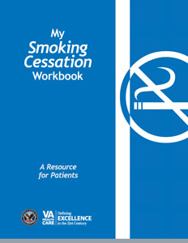
Health behavior change interventions
*Often incorporate health psychology approaches in cognitive rehabilitation treatment plan

Slide 56
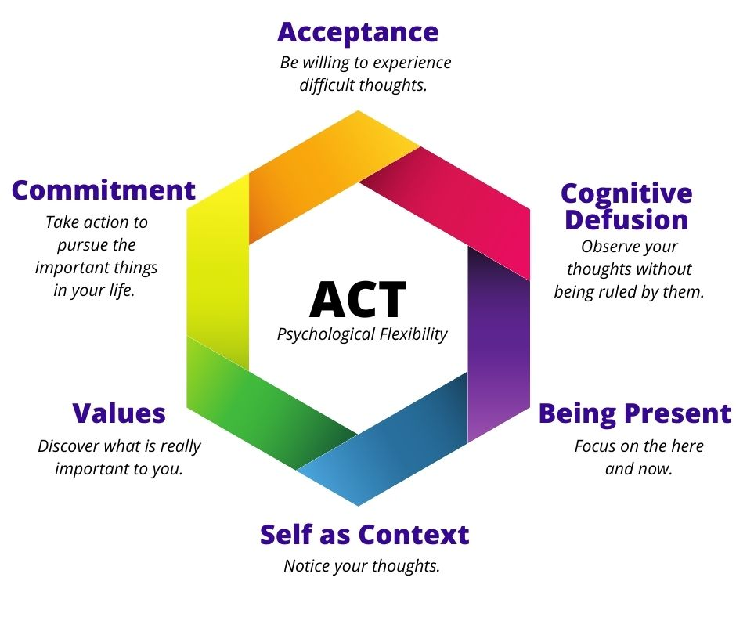
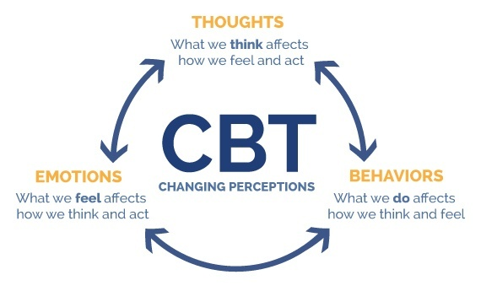

Evidence-based psychotherapy for people with MS
CBT for depression in PwMS is at least moderately effective at reducing symptoms (SMD = -0.45; Fiest et al., 2016)
Mindfulness-Based Interventions are effective at improving emotional wellbeing in PwMS (Simpson et al., 2019)
Acceptance and Commitment Therapy (ACT) treatment outcomes attributed to improved psychological flexibility (Twohig & Levin, 2017)

Slide 57


MS-Specific programs
Living well with MS: https://www.nationalmssociety.org/Living-Well-With-MS
Pathways to Wellness in MS: emphasis on comprehensive approaches to nutrition and exercise: Pathways to Wellness in MS | National Multiple Sclerosis Society (nationalmssociety.org)

Slide 58
National MS Society (NMSS) WOrkshops
Relationship Matters
Resilience
Cognifitness

Slide 59

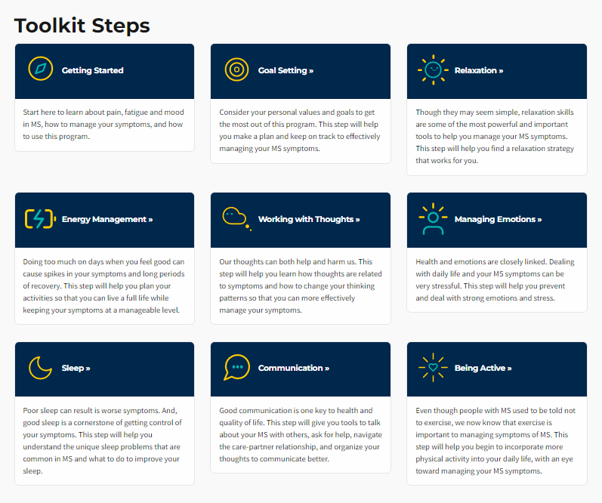
MS-Specific programs
“…web-based, self-guided, symptom self-management program specifically for people living with MS symptoms.” My MSToolkit – A toolkit for those with MS

Slide 60



Services Offered at the VA Maryland
Health Care System (VAMHCS)
Screening
Brief and comprehensive inpatient & outpatient neuropsychological evaluation
Multidisciplinary MS Clinics
Capacity evaluations
Teleneuropsychological evaluations
Telemental health
Individual/group cognitive rehabilitation
Individual/group psychotherapy
Cognitive wellness groups
Computerized cognitive rehabilitation (research)
MS Professional Outreach and Advocacy

Slide 61
cognitive wellness Group: MS Intervention and Development of Skills (MINDS) - content
Social support
Psychoeducation
Comorbidities
Workshops & Guest speakers
Health behaviors
Cognitive rehabilitation
Mindfulness

Slide 62

Group cognitive wellness: minds (process)
Ongoing Dialogue and Feedback
Client Goals & Values
Evidence Based Interventions
Tailored Treatment Plan

Slide 63
MANY MINDS
MINDS 1.0
Master MINDS
Open MINDS
MINDS for Women
MINDS for Men
Caring MINDS
Mindful MINDS
Working MINDS

Slide 64
VAMHCS Neuropsychology MS WOrkshops
Exercise &
MS
Nutrition & MS
Sleep &
MS
Pain &
MS

Slide 65


What If Your Site Does Not Have Access to Neuropsychological or psychological assessment Services?
Is there a comprehensive MS center in the area where you can refer your patient?
  NMSS, CMSC, MSCoE, & PVA can be very helpful
Perform screening and try to address modifiable factors
Is telehealth an option?
https://www.nationalmssociety.org/
https://www.mscare.org/
https://www.va.gov/ms/
https://pva.org/

Slide 66
Take Home Points
MS is a heterogeneous disease and each person’s presentation is unique and may be impacted by sociocultural factors and comorbidities. Understanding the context in which the disease occurs is critical in promoting tailored clinical care.
  Cognitive and psychological symptoms commonly occur in individuals with MS and can negatively affect occupational, social, and daily function.
  Assessment of cognitive and psychological status should be routine components of comprehensive MS care.
    Subjective appraisals by providers and/or brief screening measures alone are NOT adequate for diagnosis.
  Comprehensive, holistic approaches to assessment and intervention that incorporate the empirical base and a client’s values, goals, and care communities are recommended.
    Comprehensive assessment can facilitate tailored intervention approaches.

Slide 67
Survey
Please complete the webinar survey in the
TRAIN or TMS websites within 15 days. This will give you access to your CME/CE certificate.
Non-VA: www.vha.train.org
VA: www.tms.va.gov

Slide 68

What’s On Your Mind?
Please type your question into the Chat
area in the lower right corner of your screen.
Notes:
Live questions

Slide 69
VA MS Centers of Excellence
National MS Society
Website: www.va.gov/MS
Remote clinical consults within VA
VA specific MS care information
  Benefits, grants, adaptive equipment, referrals
  MS quality measures, MSSR, DMT use criteria
Educational opportunities
  Healthcare Professional
  Monthly clinical e-newsletter
  Monthly webinars
  Conference presentations
  Annual network meetings
  Veteran
  Monthly podcast
  Quarterly e-newsletter
  Webinars in collaboration with non-VA MS and Veteran service organizations
Website: www.nationalmssociety.org
Professional Resource Center
  Clinical publications
  Literature search
Support
  MS Navigator
  Self-help groups
  MSFriends
Educational Opportunities
  Healthcare Professional
  Webinars (ECHO, VA, Pediatric, Mental Health)
  National and local e-newsletters
  Fellowships and mentoring
  Patient
  Ask an MS Expert series
  Virtual Programs (New to MS, Black MS Experience, Hispanic/Latinx Experience, & more)

Slide 70
Thank you and please join us for the next webinar on February 7, 2024!
Assistive Technology Applications
in Persons with MS
Benjamin Dons, PT, DPT
www.nationalMSsociety.org/currenttopics
www.va.gov/MS/products/CME_CEU_calls
Notes:
Thank you for your participation today and special thanks to Dr. Casperson for the great presentation. This webinar is recorded and I will posting the recording and the slides on the webpage listed on the screen. Don’t forget, there’s another Current Topics webinar on September 16 on Medical Marijuana for MS Symptom Management presented by Dr. Michelle Cameron. You can register online for this webinar on our website noted on the screen. Thank you all for attending today and have a great rest of your day.

